Slide 1

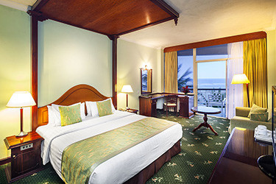
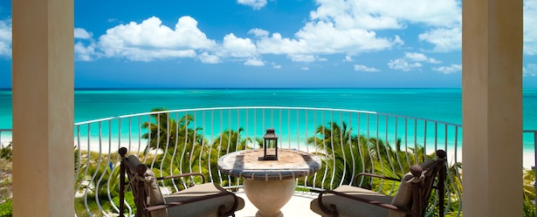
Hotel Reservation System
Ocean View Hotel-Colombo

Slide 2

INTRODUCTION
Hotel Ocean view is one of the famous tourist hotels in Colombo. But when guest make a reservation through phone or do it onsite they still use the old way of manual data recording. It takes a long time and all the details of reservation are recorded in files. Those files are stored in a special cabinet .Calculating the bills and details of available room are done by manually too.

Slide 3

As the current System is a file based one, management of the hotel has to put much effort to keep those files safe and secure .They can easily get damaged by fire, insects or even by a natural disasters .And also if it’s stolen it will be more concerning. Keeping files safe and recording details manually takes much time and wastes much precious man hours .We can’t trust the accuracy of calculation done by manually, it’s not a surprise of encountering problems. We decide to develop their Reservation System as a computerized system ,so hotel can give efficient service for guests and guest can also feel safe about their information in the system.

Slide 4

OBJECTIVES & AIMS
Manual reservation system replaces by Computerized system.
It’s more efficient and productive.
Develop a database which store guest’s details & user’s details when user entered their details.
Create an easy to use & understand user friendly environment.
Guest can get fast registration service.
The guest can book the rooms through Phone call or in person.
Guest will receive confirmation Email after registration.

Slide 5
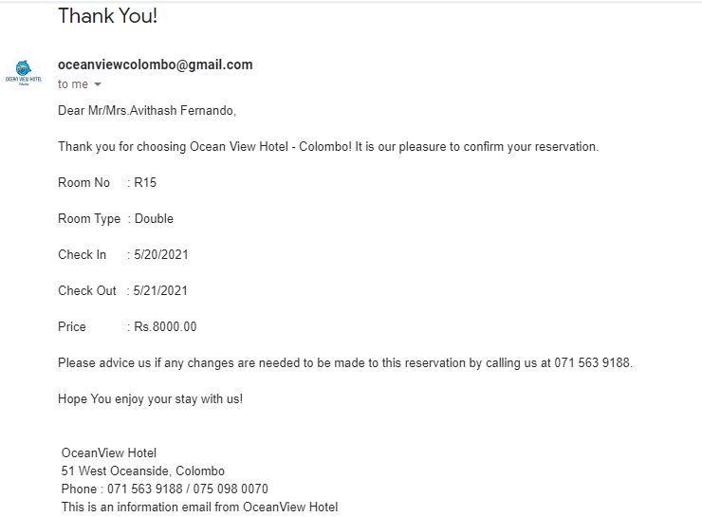
NEW TECHNOLOGYS
System to send an Email to the guest after guest registration

Slide 6
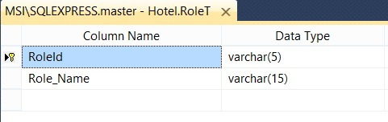
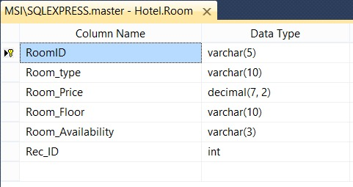
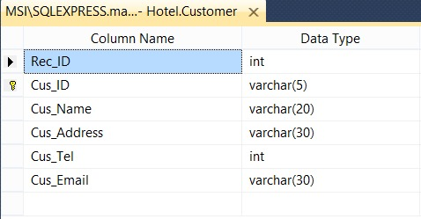
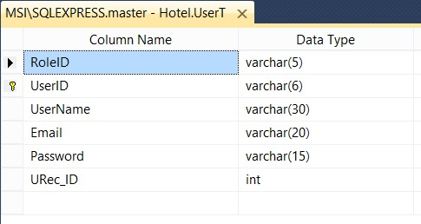
DATABASES

Slide 7
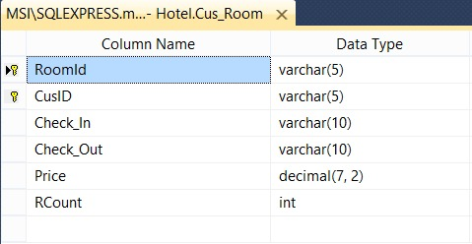
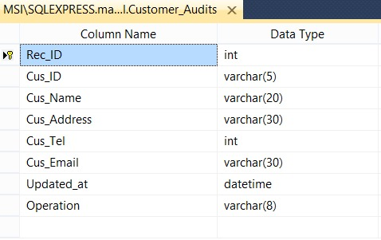
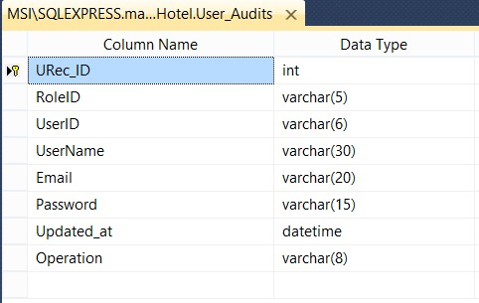
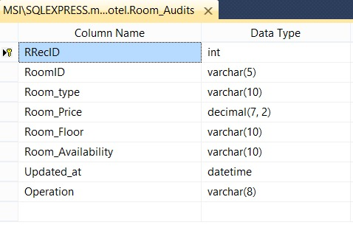

Slide 8
USER ROLES
Role Name | Description
Administrator | The administrator has the full authority on the system maintenance and the ability to create or edit user details and rooms. Administrator has the ability to check the Database and action done by user role.
Manager | Manager has the ability to get reports about user accounts , Guest details by check in and check out dates , he can also get a report of guests on specific location. Manager can also see logs.
Receptionist | Receptionist able to see available rooms ,register guests , assign guests to a room and edit guest details.

Slide 9
METHODOLOGY
The Development process will do according to the process of Waterfall model.
Since we have identified the main requirements waterfall model is most suitable methodology to build up this system.
The main phases of this phases are,
Requirements Gathering & definition.
Requirements Analysis.
Design & implementation.
Testing
Maintenance & Evaluation.

Slide 10

REFERENCES
Websites
www.c-sharpcorner.com
www.W3schools.com
www.Youtube.com
https://github.com/
https://stackoverflow.com/

Slide 11
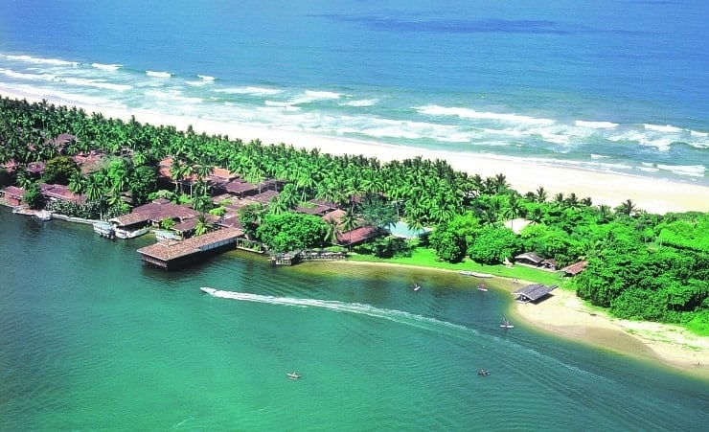
Group Members
J.N Jansz codse201f-063
R.A.R.K Ranasinghe codse201f-026
K.A.C Fernando codse201f-047
H.V.R.T Premathilaka codse201f-044
Thank you…!

